Slide 1


Power BI Report - Northwind Traders
View in Power BI

Slide 2
Project Overview
This project focuses on developing a comprehensive and interactive business intelligence dashboard for Northwind Traders, dealing the import and export of specialty food products.
The dashboard aims to consolidate various aspects of the company's operations—customer behaviour, employee performance, inventory movement, supplier engagement, and order transactions—into meaningful visual insights that support informed strategic decision-making

Slide 3
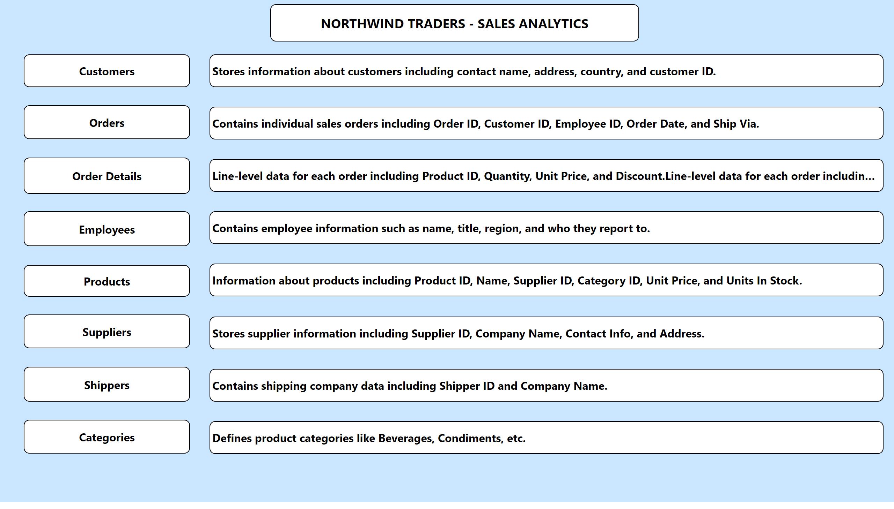
Overview
Notes:
shape
No alt text provided
shape
No alt text provided
shape
No alt text provided
shape
No alt text provided
shape
No alt text provided
shape
No alt text provided
shape
No alt text provided
shape
No alt text provided
shape
No alt text provided
shape
No alt text provided
shape
No alt text provided
shape
No alt text provided
shape
No alt text provided
shape
No alt text provided
shape
No alt text provided
shape
No alt text provided
shape
No alt text provided

Slide 4
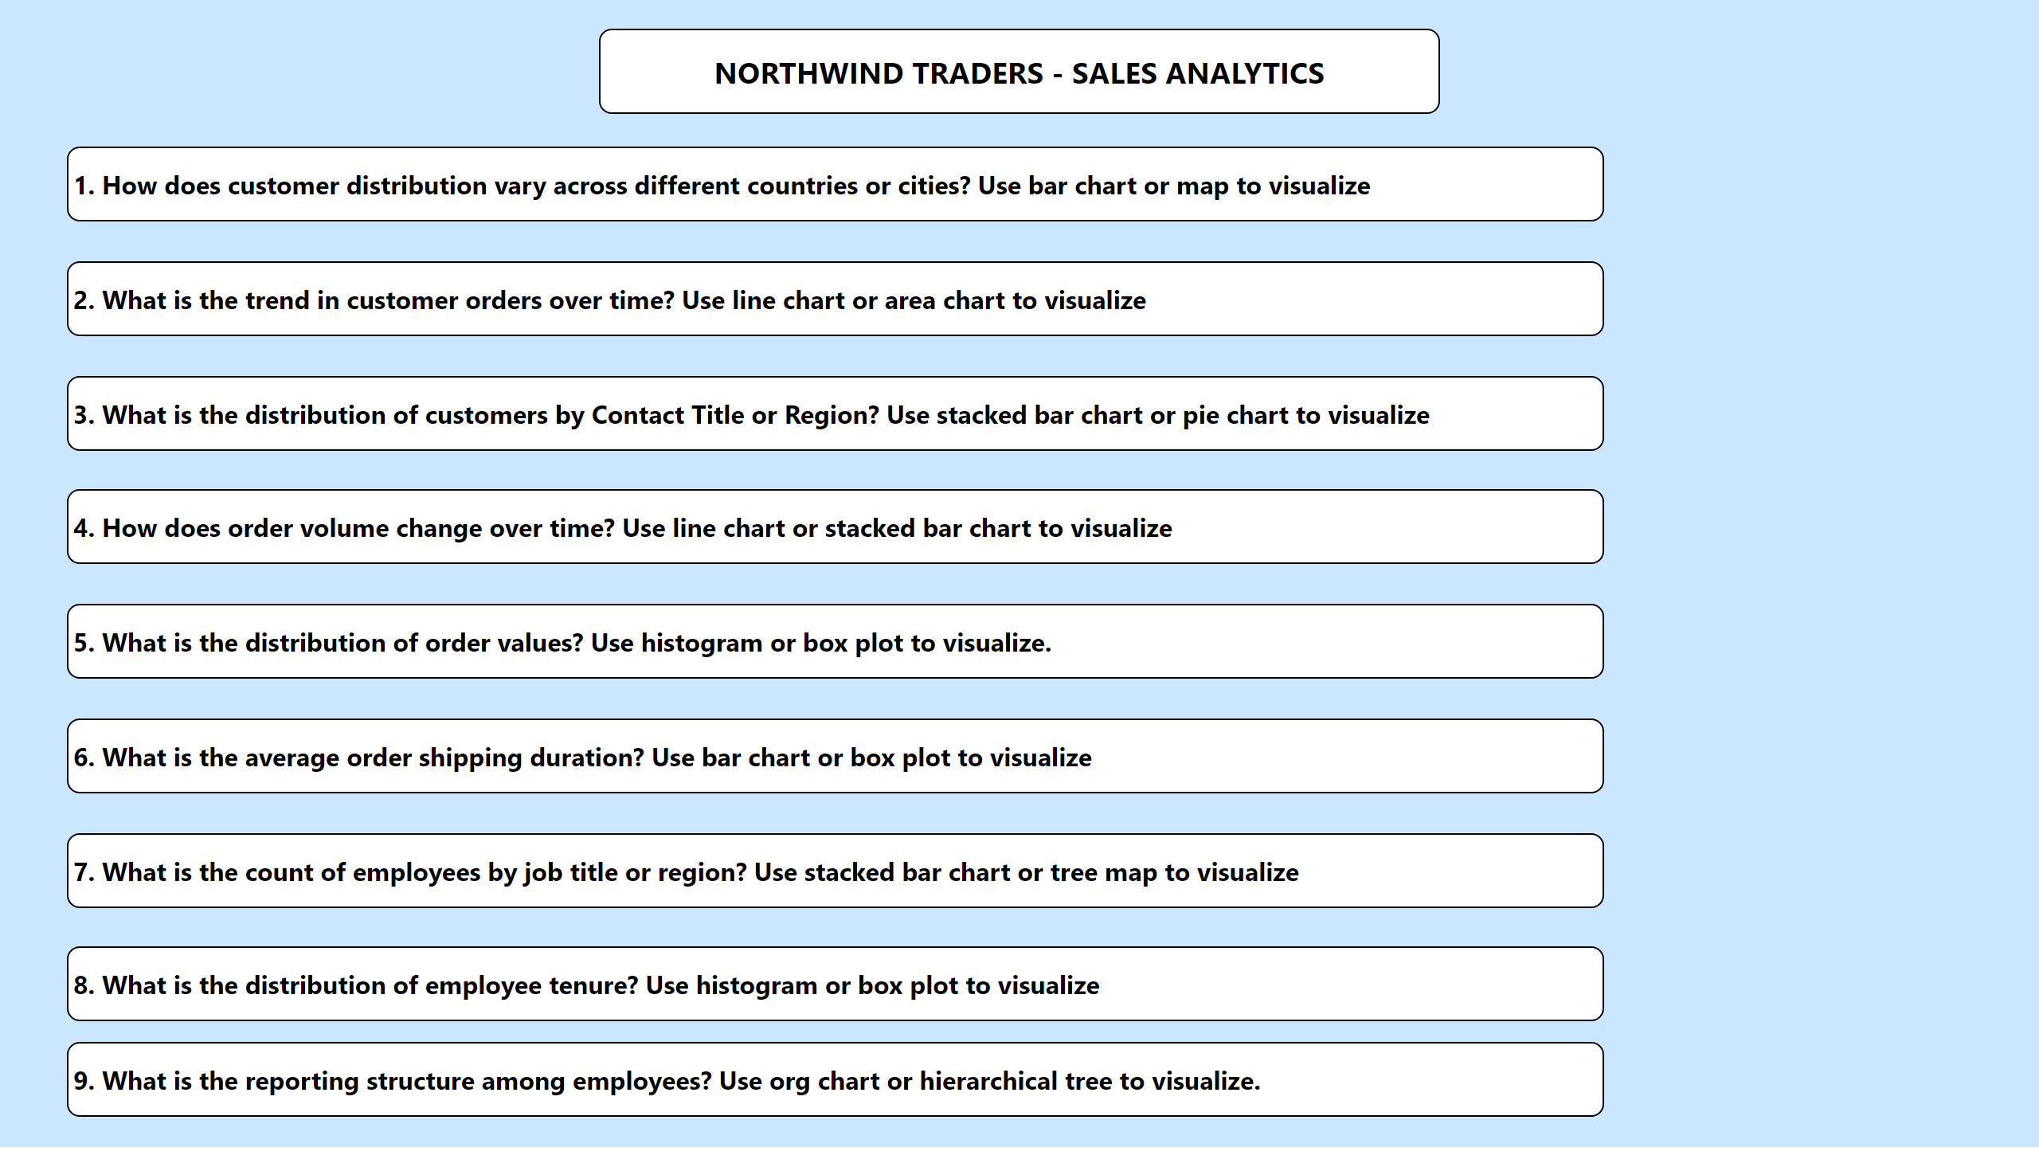
Navigation
Notes:
shape
No alt text provided
shape
No alt text provided
shape
No alt text provided
shape
No alt text provided
shape
No alt text provided
shape
No alt text provided
shape
No alt text provided
shape
No alt text provided
shape
No alt text provided
shape
No alt text provided

Slide 5
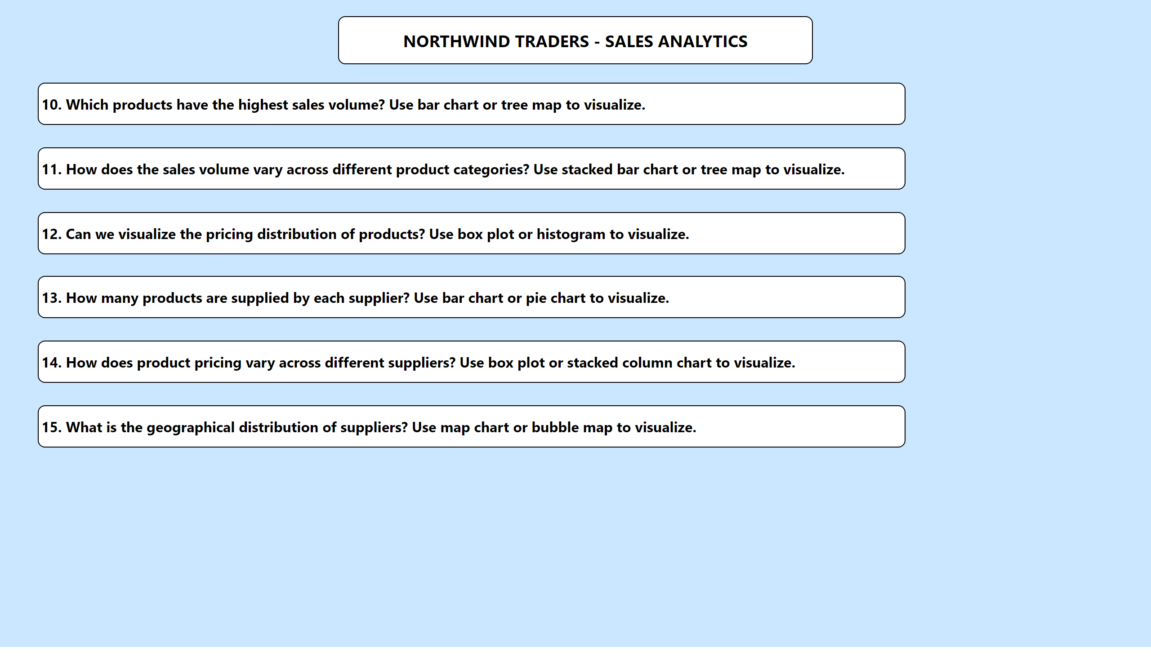
Navigation
Notes:
shape
No alt text provided
shape
No alt text provided
shape
No alt text provided
shape
No alt text provided
shape
No alt text provided
shape
No alt text provided
shape
No alt text provided

Slide 6
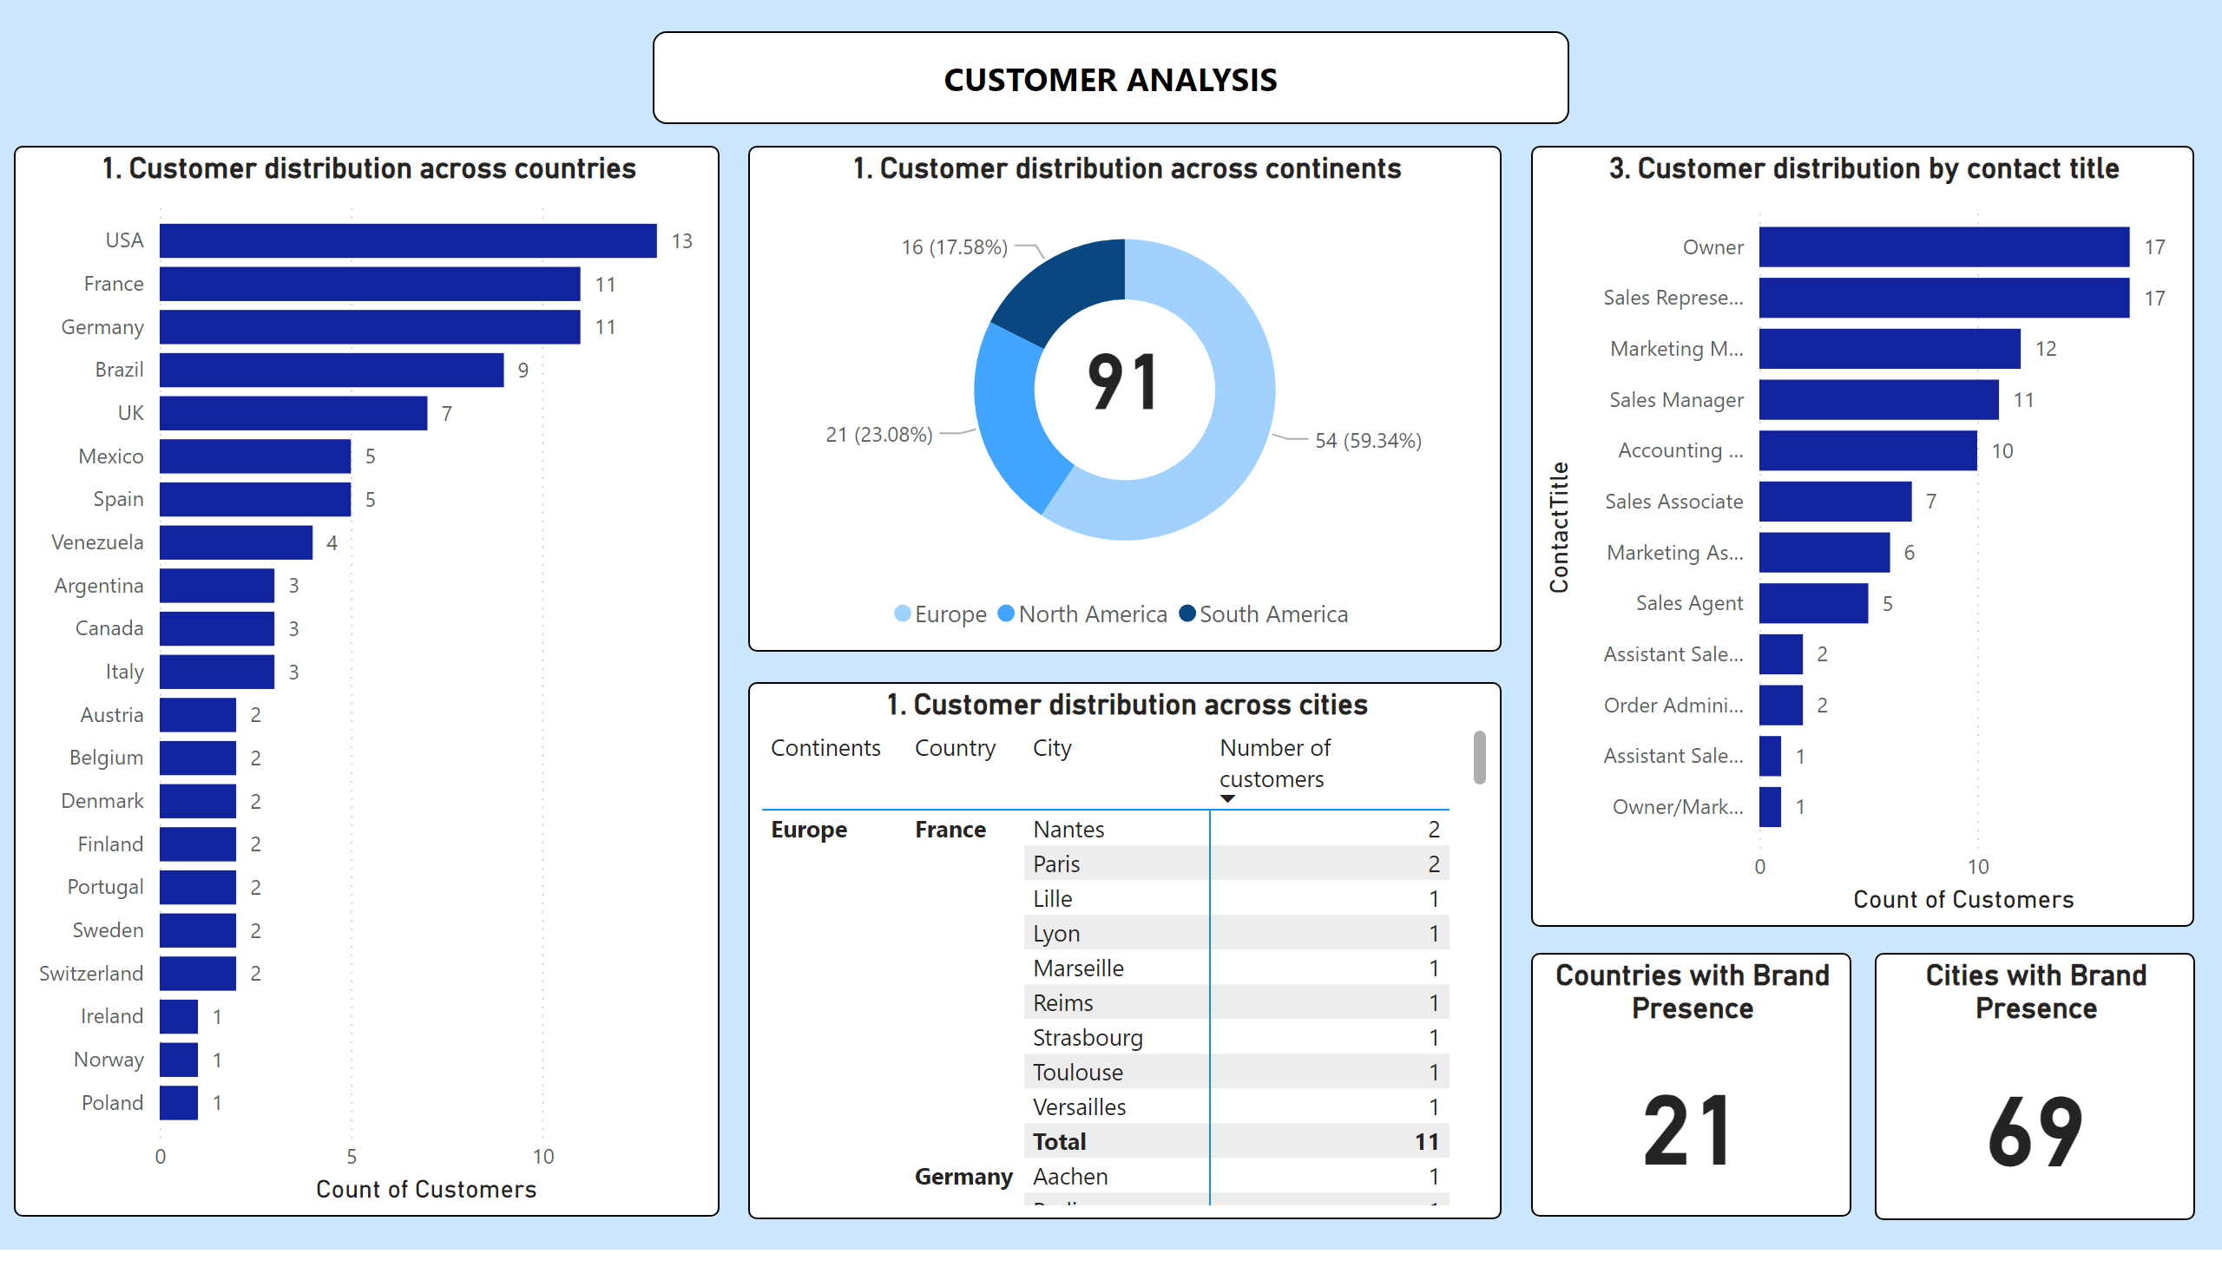
1
Notes:
shape
No alt text provided
1. Customer distribution across countries
No alt text provided
1. Customer distribution across continents
No alt text provided
card
No alt text provided
1. Customer distribution across cities
No alt text provided
3. Customer distribution by contact title
No alt text provided
Cities with Brand Presence
No alt text provided
Countries with Brand Presence
No alt text provided

Slide 7
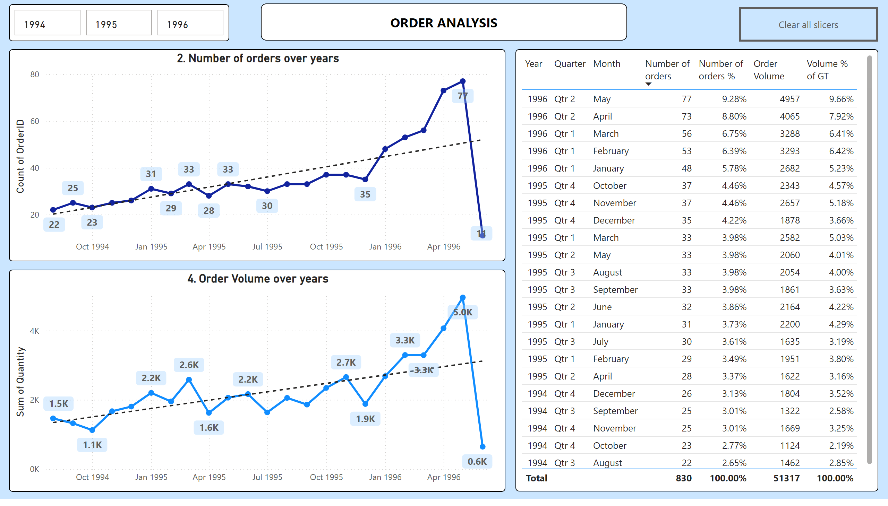
2
Notes:
shape
No alt text provided
2. Number of orders over years
No alt text provided
2. Number of orders over years
No alt text provided
4. Order Volume over years
No alt text provided
advancedSlicerVisual
No alt text provided
actionButton
No alt text provided

Slide 8
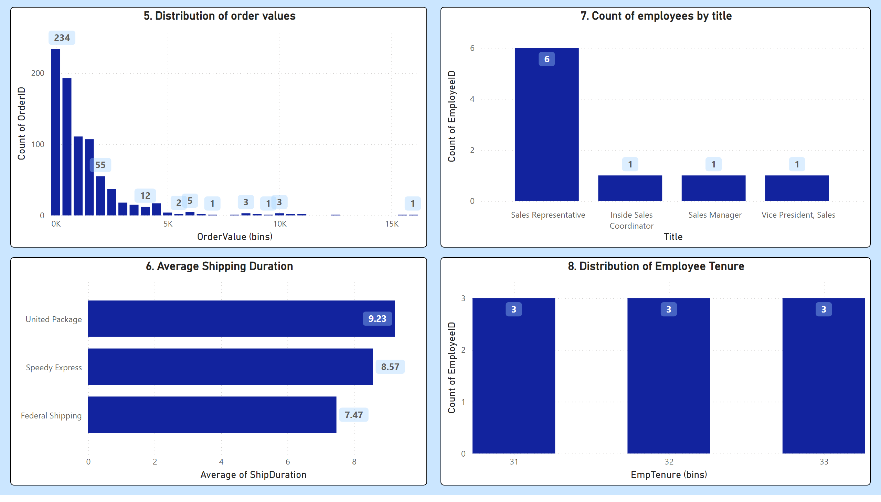
3
Notes:
5. Distribution of order values
No alt text provided
6. Average Shipping Duration
No alt text provided
7. Count of employees by title
No alt text provided
8. Distribution of Employee Tenure
No alt text provided

Slide 9
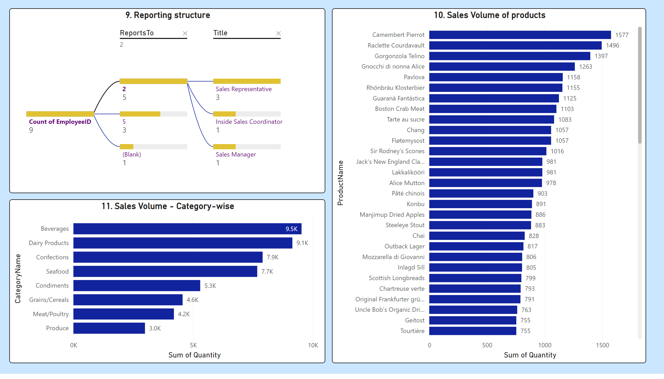
4
Notes:
9. Reporting structure
No alt text provided
10. Sales Volume of products
No alt text provided
11. Sales Volume - Category-wise
No alt text provided

Slide 10
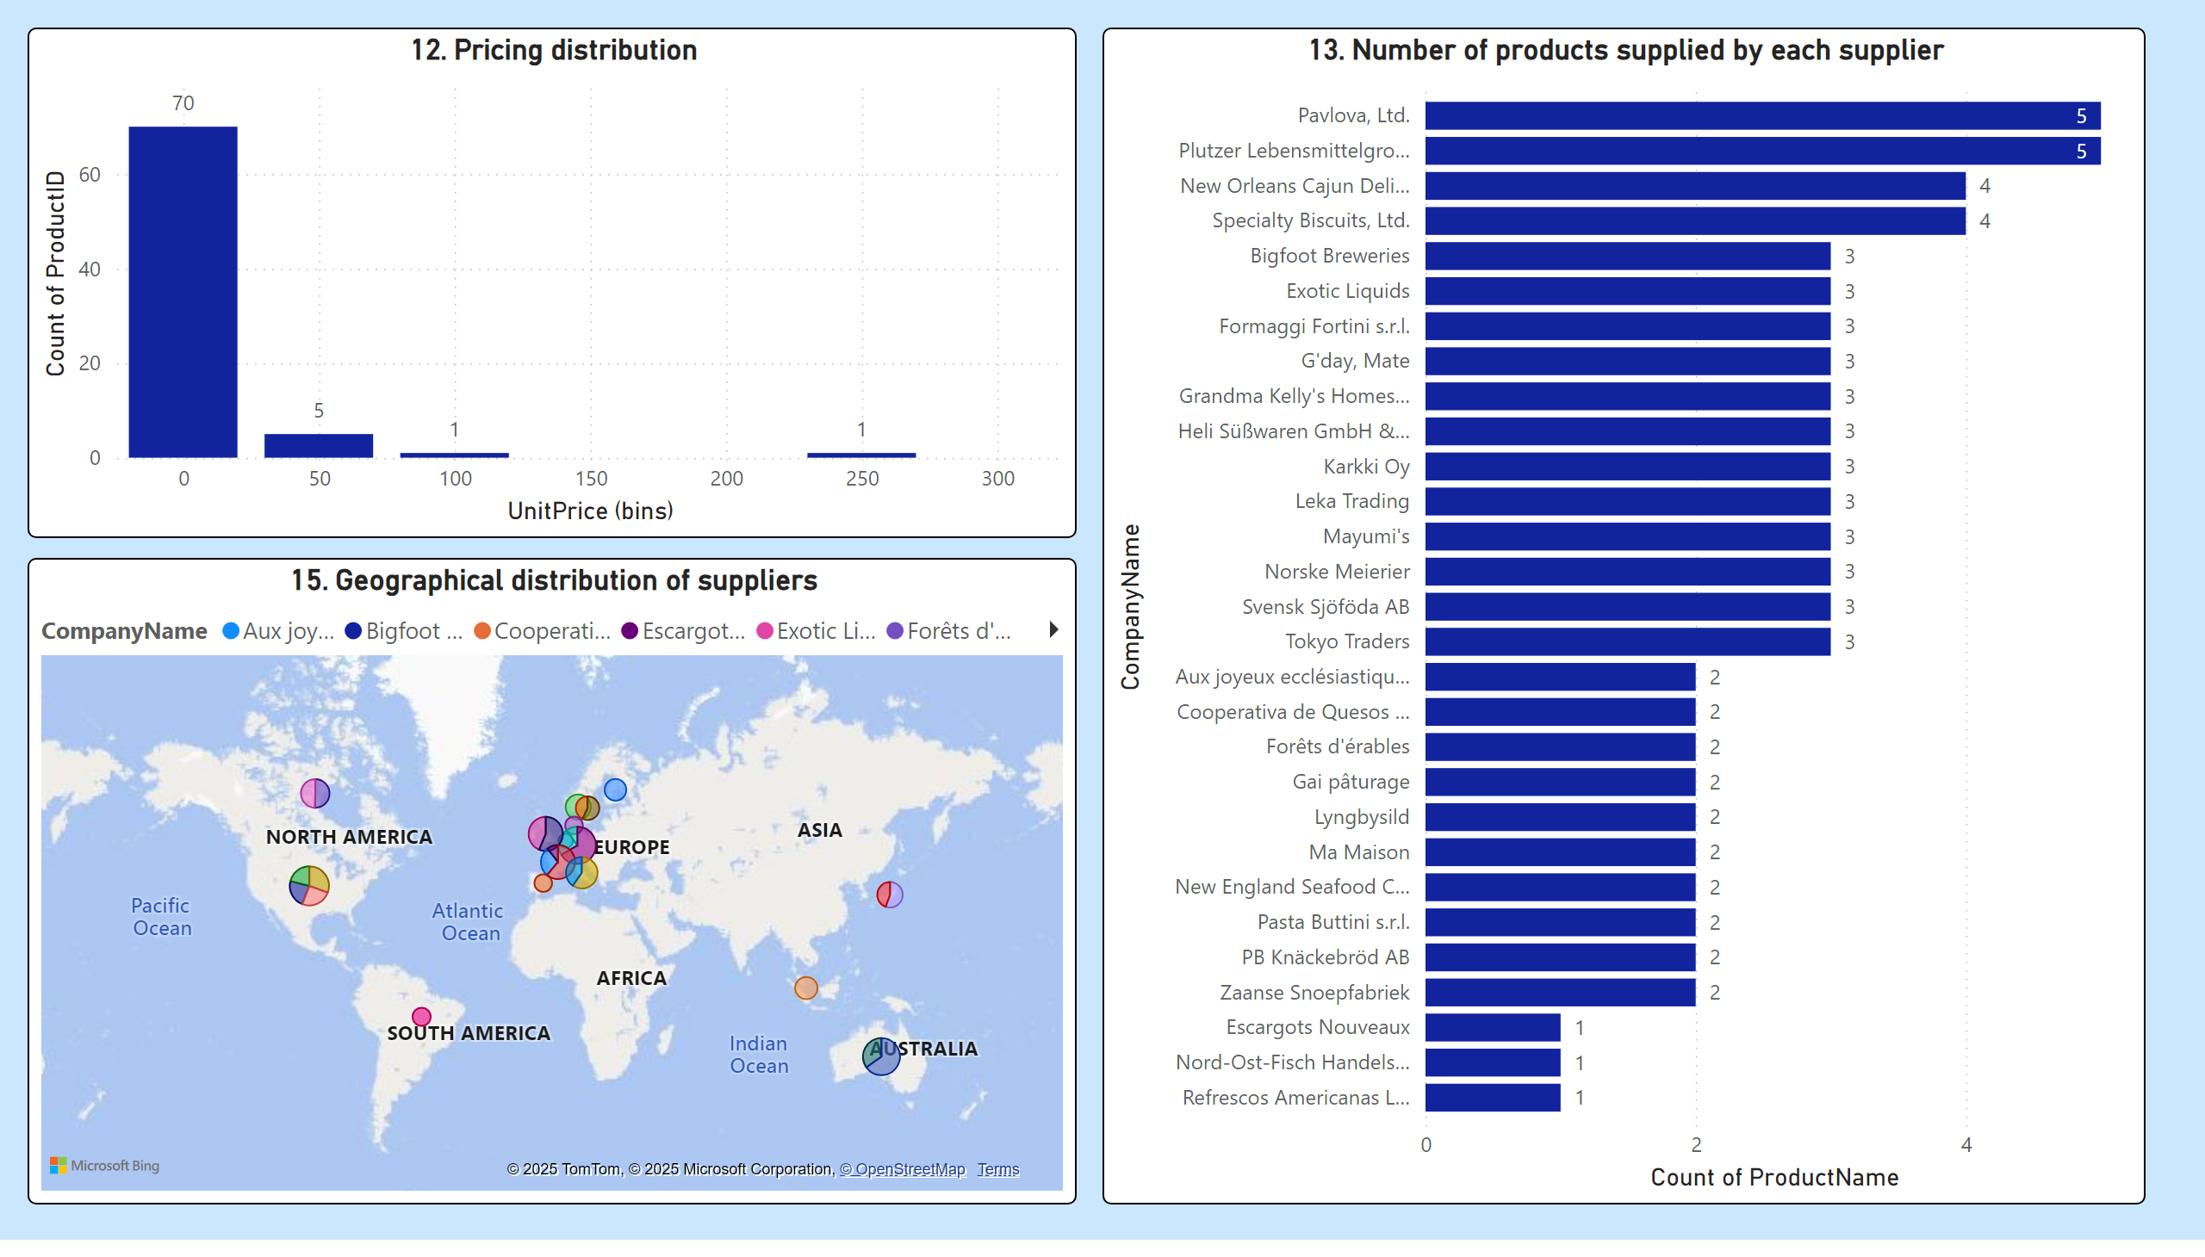
5
Notes:
13. Number of products supplied by each supplier
No alt text provided
12. Pricing distribution
No alt text provided
15. Geographical distribution of suppliers
No alt text provided

Slide 11
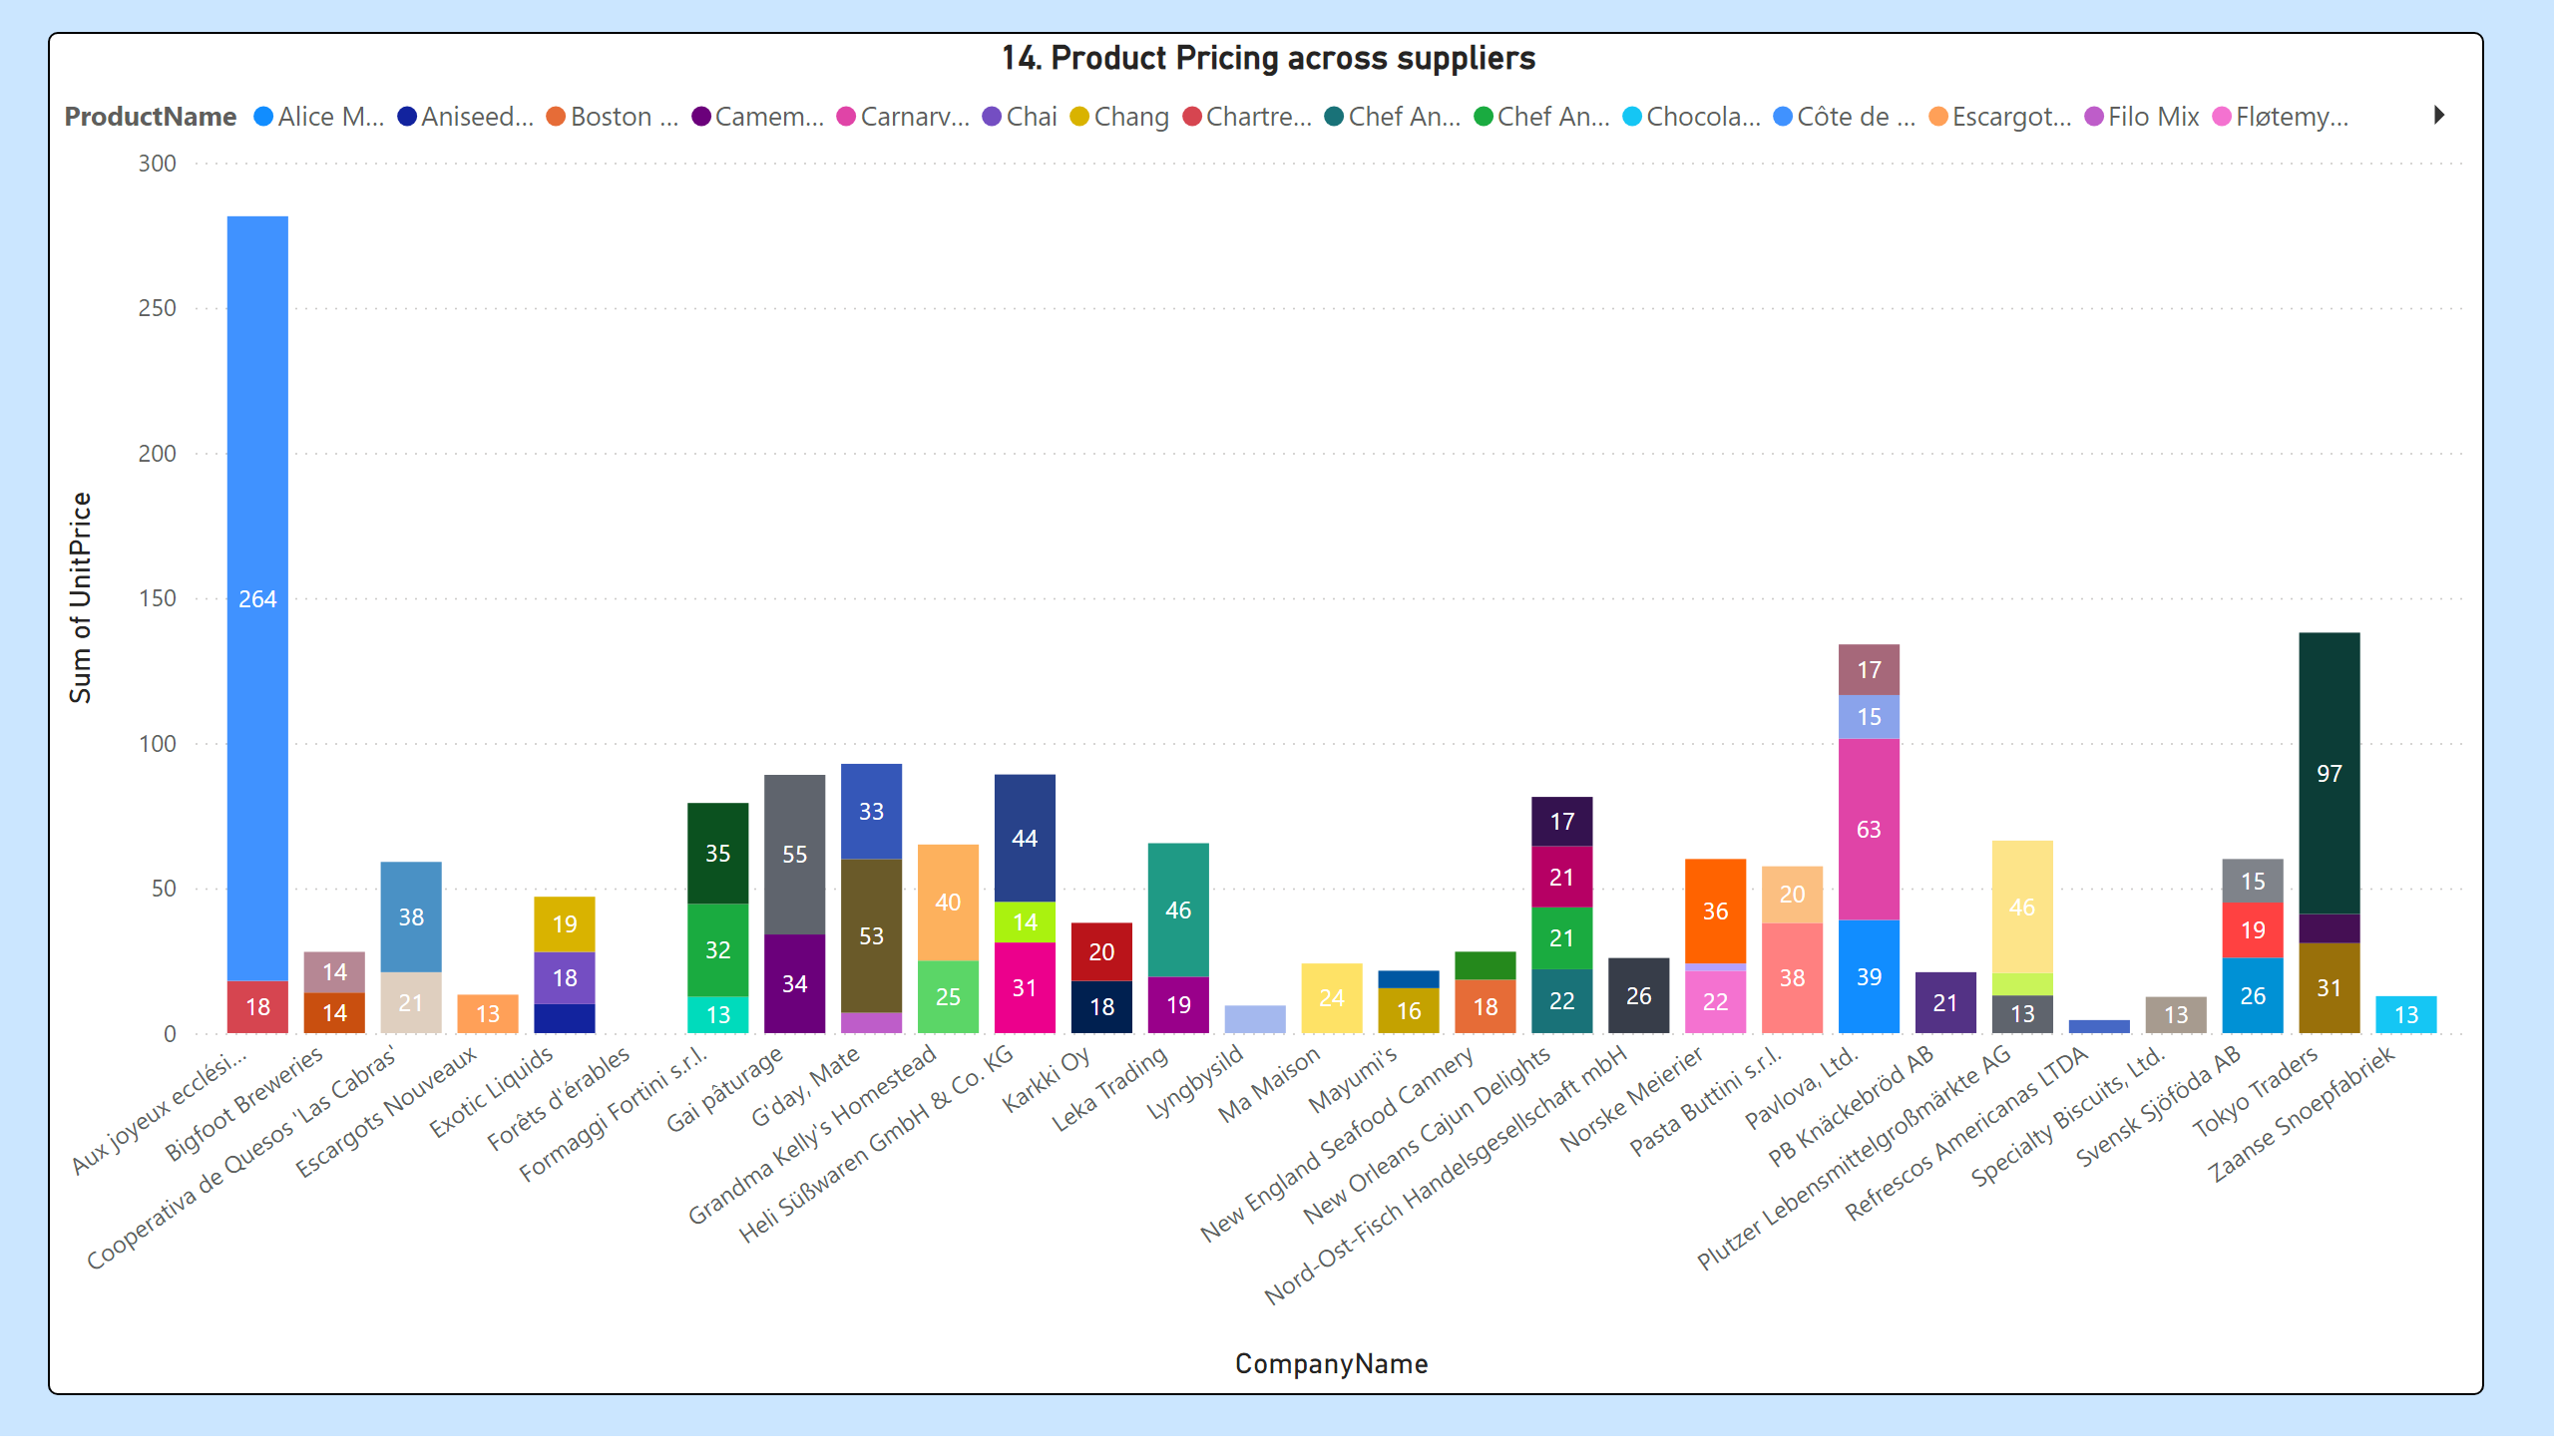
6
Notes:
14. Product Pricing across suppliers
No alt text provided

Slide 12
CONCLUSION
Real-time decision-making: Through slicers, filters, and dynamic charts.
Business growth opportunities: Identified by drilling into high-performing products, stores, and customer segments.
Cost optimization avenues: In procurement and logistics through supplier price analysis and order bin sizing.

